Slide 1
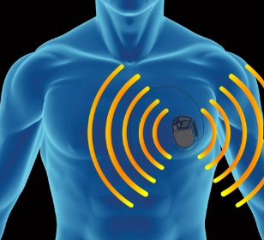
Data Security and Privacy in Wireless Implantable Medical Devices (IMDs)
Notes:
1.5m
they have been around for a long time. IMDs has provide many solution for many dieses.
It’s a fact that it improve the life quality for many patient
IMDs contanin sensitive and private info that only doctors should be able to monitor and modify
Even though these device provide safety and utility, it doesn’t really assure the security and privacy for the patient
As we will see in the presentation

Slide 2
Overview
Solution
Agenda
Design constraints
Security Requirements
Attack
External device
Anomaly detection
Audit mechanism
Access control
Notes:
Overview
Agenda
It’s a broad topic, given that I only have 20m here what I will cover

Slide 3
Introduction
IMDs are Tiny programmable device placed inside the human bodies to analyze, monitor and respond to treat various medical conditions.
Designed in a manner to communicate wirelessly with the outside caregiver to have access to the patient’s data remotely.
Provide radical way to communicate between doctor and patient, but it face constraints for providing encrypted communication and monitoring service

Slide 4
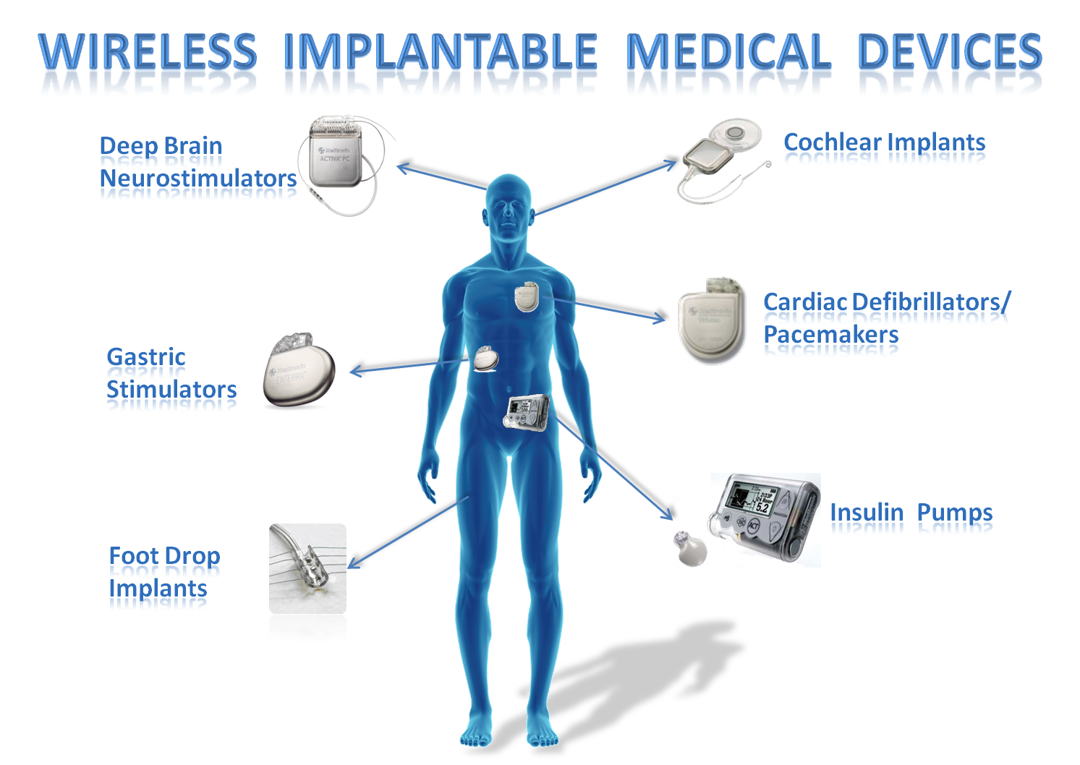
Notes:
Pacemaker: generate electric impulses to control abnormal heart rythms
Examples: Dieses and related device
Dieses: diabetes, cardiac arrhythmia, cochlear, gastric.
What if there is a malicious person what if things go wrong/ south
human-computer immunodeficiency virus
information harvesting, tracking the patient, impersonation,relaying attacks and denial of service attack
information contained in the
devices can be openly accessed by adversary
-attacks such as eavesdropping wireless communication or
controlling other medicinal gadgets to modify the expected
Treatment
---
Attack can range from passifly eversdrop and aim to collect patent info to couse harm to patient include death.
Malicious update, untrusted network

Slide 5
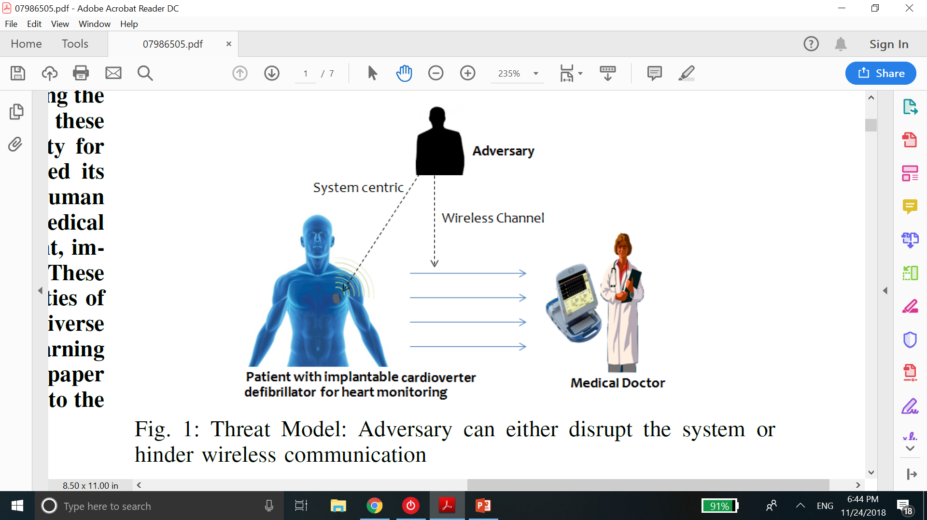
Design Constraints
Internal level constraints:
- Should be small and efficient
- Non-rechargeable battery
- Security protocol drains battery for its numerous processing.
- Exchanging logs may cause DoS attack
Communication level constraints:
- Numerous amount of radiation can be harmful.
- Wireless channel faded through patient body
Notes:
Being able to maniblate these device, threaten the life of many device.
Battery live 10y
Security protocol: cryptography, machine learning, hashing
In case the battery exhausted, imd needs to be replaced which need surgery
Device need to audit and keep logs of internal process and process with with outside. But the attacker may take advantage of that
Many security mechanism work based on the fact that legitimate channel is the strongest and this is not the case all the time
Use low transmission power to increase the device lifetime and because of that most of sec technique don’t work effecintly
- Legitimate channel not always the strongest

Slide 6
Security requirement for IMDs
CIA: Confidentiality, Integrity, Availability
Access control
Authentication
Authorization
Accountability
Freshness
Robustness
Notes:
Integrity: encryted and stronger authentication
Avaliability: main obj of installing imd for doctor to have access and treat the patient whenever it needed
Accountability: It is the act of being explained and
justifiable. IMDs keep review logs to track for potential
breakdowns on the device
Freshness: operation non redundant (in case DoS)
Rubost: device able to handle abnormal situation
while designing a security management system
for the medical device, all the above security properties should
be attained for a concrete solution.

Slide 7
Attacks in IMDs
Internal attack:
- Calibration attack
- Connection or hardware attack
- Low battery attack
- Modify attack
- Malware software
Communication attack:
- Eavesdropping
- MITM (Jamming)
- DoS
- Spoofing (Replay)
- Device capture and trapping
Notes:
Ex of Insider attack: manufacturer employee, Physiscian, hospital administrator, or anyone can get hold of the internal system., health care profeicinal, software developer or hardware engineer
Calibration attack: modify the collected data to mislead the diagnostic process
Hardware attack or fuiler which can couse by third party
Battery by assign operations more than the device can handle which lead to drain the battery and make it is life time shorter than it made to be
---
The attacker can take adv of he communication channel between IMD and hospital or the doctor
Becouse of encrypted wireless chaneel and adequate authentication and access control mechanism,,
Know the status of patient health and track
Replay old message.

Slide 8
Security Solution for IMDs
Audit mechanism
Using RFID Guardian which is an external device utilize to access and monitor data and event that has been occurred. Authenticate the registered device and block unregistered entities.
Anomaly detection technique
Utilize supervised machine learning algorithm, support vector machine SVM, for learning and classification between bogus and genuine reader to reduce depletion attack.
Access control mechanism
External hardware methodology
Notes:
requires balancing security and privacy
goals with traditional goals such as safety and utility.
shared key authentication to wearable gadgets that handle encryption and approval
In the emergency situation in a foreign country, techniquesare required that can assist the doctor or unauthenticated to ease the medical process.
Detect, response, recover
…
Security mechanism for imd take into consideration the resource limitation of IMDs
--
Audit logs keep record of patient history. 75% of IMD is made to deel with the medical operation so the limited storage memory for logs make it vulnerable to DoS. Disavd: if the attacker get an access of RFID, he can also access the patient record

Slide 9
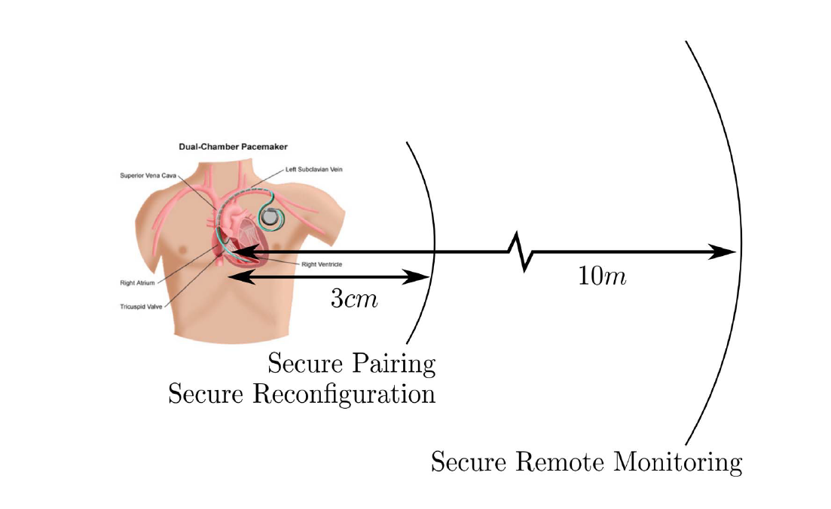
Security Solution for IMDs
Access control mechanism
Biometric approaches
Compares and searches for the characteristics against a number of samples stored within the system. prevent MITM, but it drain the memory because of the search process.
Distance based approaches
Using NFC approach to access patient information
Key management protocols
Using symmetric key via external device.
Notes:
To avoid power consumbution

Slide 10
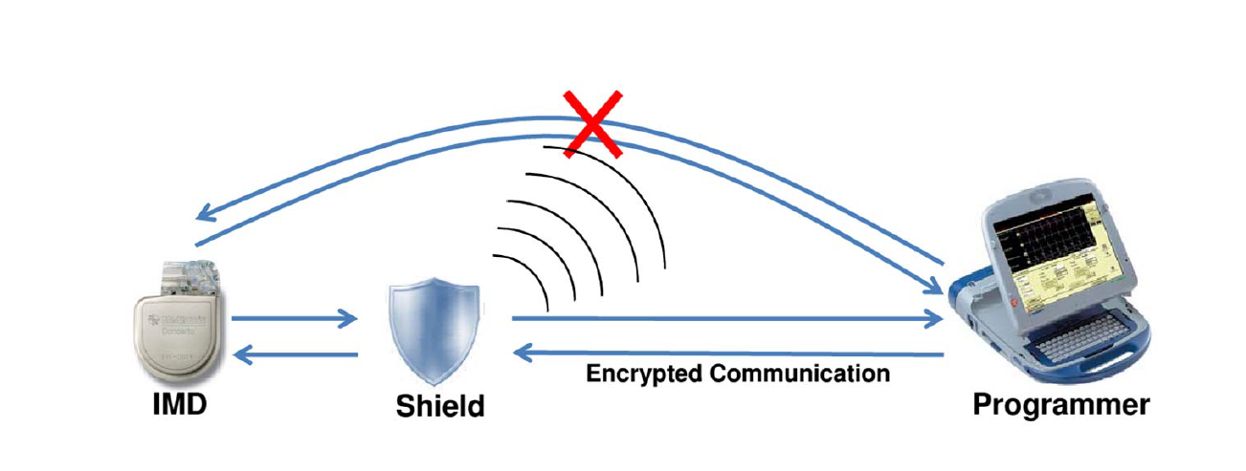
Security Solution for IMDs
External hardware methodology
- Cloaker
- IMD Shield
Notes:
Cloaker: The cloaker ensures the security of the IMD for the
time that it is worn and gives open access to the outside world
when not worn. IMD using master key. And check if the coaker is close or not. Ping or wait for confirmation. Eneter the emergency mode
IMD shield: jammer and reciver

Slide 11
Take Aways
IMD can improve healthcare, but not without fully understanding security and privacy.
Bad people do exist
I hope this will motivate you to think about the area of healthcare privacy and security
Notes:
New solution > New problem
I know it sounds redicouls that some ppl targeting the IMD and willing to attack these device and couse harm someone health just for money.
It would be a nieve thing to ignore the fact that bad ppl exist and if they have the opportunity they would do harmful things to patient including death.
As a security speacialist we have the skills and the potential to prevent or mitigate such things.
And I hope in the future by collabertaing with the medical field, we can produce more wireless implantable device that assure security and privacy

Slide 12
References
https://ieeexplore-ieee-org.ezproxy.rit.edu/stamp/stamp.jsp?tp=&arnumber=6846193
https://ieeexplore-ieee-org.ezproxy.rit.edu/stamp/stamp.jsp?tp=&arnumber=8113801
https://ieeexplore-ieee-org.ezproxy.rit.edu/stamp/stamp.jsp?tp=&arnumber=8074857
https://ieeexplore-ieee-org.ezproxy.rit.edu/stamp/stamp.jsp?tp=&arnumber=8417241
https://ieeexplore-ieee-org.ezproxy.rit.edu/stamp/stamp.jsp?tp=&arnumber=8113797
https://ieeexplore-ieee-org.ezproxy.rit.edu/stamp/stamp.jsp?tp=&arnumber=8125887
https://ieeexplore-ieee-org.ezproxy.rit.edu/stamp/stamp.jsp?tp=&arnumber=8510797
https://pdfs.semanticscholar.org/d98f/2a7857ffbd0c883a8884531a254febea7684.pdf
https://ieeexplore-ieee-org.ezproxy.rit.edu/stamp/stamp.jsp?tp=&arnumber=4431854
https://ieeexplore-ieee-org.ezproxy.rit.edu/stamp/stamp.jsp?tp=&arnumber=7015957
https://ieeexplore-ieee-org.ezproxy.rit.edu/stamp/stamp.jsp?tp=&arnumber=7986505
https://ieeexplore-ieee-org.ezproxy.rit.edu/stamp/stamp.jsp?tp=&arnumber=6241484
https://ieeexplore-ieee-org.ezproxy.rit.edu/stamp/stamp.jsp?tp=&arnumber=7905288
https://ieeexplore-ieee-org.ezproxy.rit.edu/stamp/stamp.jsp?tp=&arnumber=5416350
https://groups.csail.mit.edu/netmit/IMDShield/paper.pdf
Notes:
Site those in your free time
Here are the reference I used to prepare for the presentation
Mohan, A. (2014). Cyber Security for Personal Medical Devices Internet of Things. 2014 IEEE International Conference on Distributed Computing in Sensor Systems. doi:10.1109/dcoss.2014.49
Security and Privacy for Implantable Medical Devices. (n.d.). Retrieved from https://spqr.eecs.umich.edu/papers/b1kohFINAL2.pdf

Slide 13

Notes:
Picture
Fun fact
Ok this is the end of the presentation thank you all for your attention and please feel free to ask any question

